Slide 1
MTE 481 FDP
Group 2
Collision Avoidance for Powered Wheelchairs

Slide 2
Needs Statement
Powered wheelchairs can improve the mobility of the physically handicapped, but alertness and control are required for safe operation. Additional assistive technology is needed in order to afford the same benefits to the more severely disabled.

Slide 3
Objectives and Constraints
Make powered wheelchairs accessible to people who would otherwise be denied due to safety concerns
Must improve the safety of powered wheelchairs, for the occupant and for nearby pedestrians
It must be possible to integrate with existing models of wheelchairs

Slide 4
Criteria
Criteria | Mechanical | Weight
 |  | Size
 |  | Durability
 | Cost | Price
 |  | Power Consumption
 | Sensing | Field of Vision
 |  | Range
 |  | Precision
 |  | Quantity of useful data
 | Processing | Required processing power

Slide 5
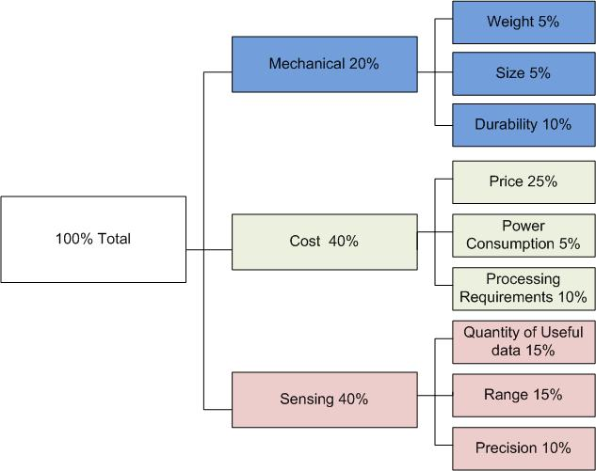
Criteria

Slide 6
Sensor Selection
 |  | Kinect |  | Lidar |  | Stereo Vision |  | Ultrasonic |  | Infrared
Criteria | Weighting | Result | Score | Result | Score | Result | Score | Result | Score | Result | Score
Weight | 0.05 | 0.2 | 0.01 | 0.2 | 0.01 | 0.2 | 0.01 | 0.1 | 0.005 | 0.1 | 0.005
Size | 0.05 | 0.25 | 0.0125 | 0.3 | 0.015 | 0.3 | 0.015 | 0.1 | 0.005 | 0.1 | 0.005
Durability | 0.1 | 0.5 | 0.05 | 0.3 | 0.03 | 0.3 | 0.03 | 0.7 | 0.07 | 0.7 | 0.07
Price | 0.25 | 0.1 | 0.025 | 1 | 0.25 | 0.5 | 0.125 | 0.03 | 0.0075 | 0.01 | 0.0025
Power Consumption | 0.05 | 0.5 | 0.025 | 0.5 | 0.025 | 0.5 | 0.025 | 0.1 | 0.005 | 0.1 | 0.005
Required Processing Power | 0.1 | 0.7 | 0.07 | 0.5 | 0.05 | 1 | 0.1 | 0.2 | 0.02 | 0.2 | 0.02
Field of Vision | 0.15 | 0.4 | 0.06 | 0 | 0 | 0.3 | 0.045 | 0.8 | 0.12 | 0.8 | 0.12
Range | 0.15 | 0.4 | 0.06 | 0.1 | 0.015 | 0.6 | 0.09 | 0.4 | 0.06 | 1 | 0.15
Precision | 0.1 | 0.5 | 0.05 | 0.1 | 0.01 | 0.5 | 0.05 | 0.75 | 0.075 | 0.75 | 0.075
Total | 1 |  | 0.3625 |  | 0.405 |  | 0.49 |  | 0.3675 |  | 0.4525

Slide 7
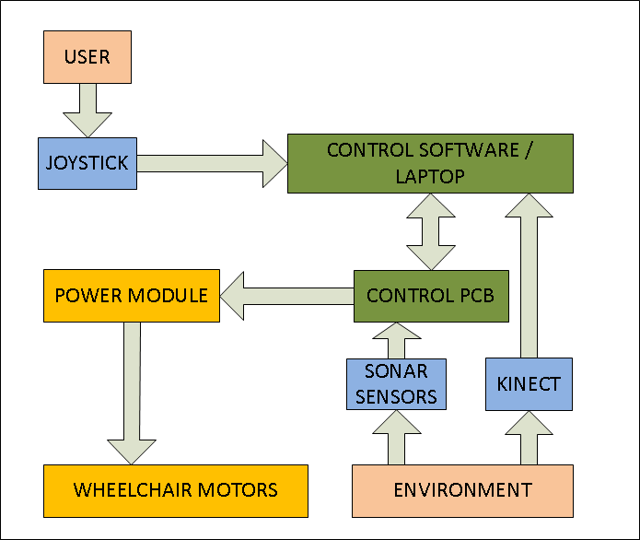
High Level Operation

Slide 8
Mechanical Progress
Cad Model
Prototypes
Final Design

Slide 9
Prototypes
Show Rowan’s Drawings Here

Slide 10
Final Mechanicals

Slide 11
Sensor Progress
Integration of Kinect with ROS
Collision Map Generation
Integration of sonar sensors with ROS
Evaluation of Kinect and sonar sensor
Discussion of final configuration

Slide 12
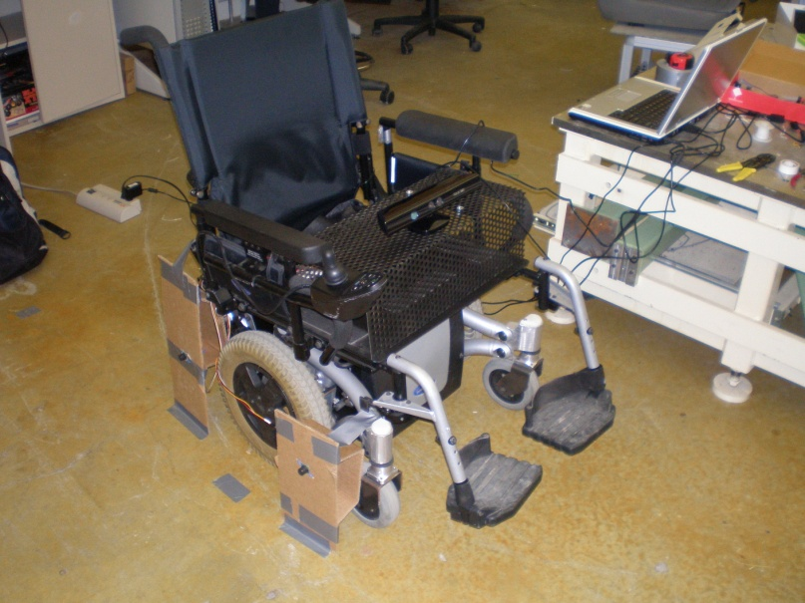
Testing/Integration

Slide 13
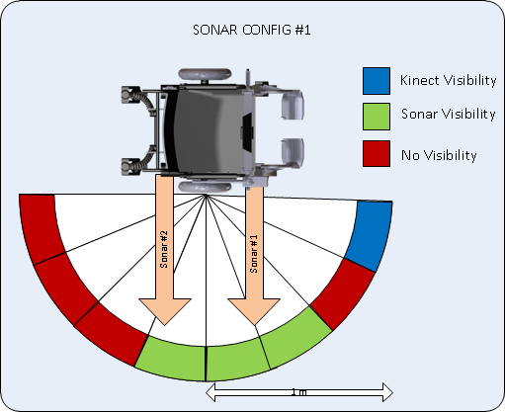
Testing/Integration

Slide 14
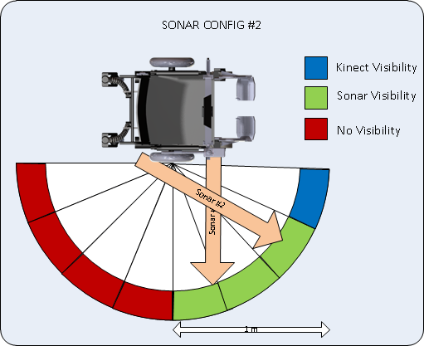
Testing/Integration

Slide 15
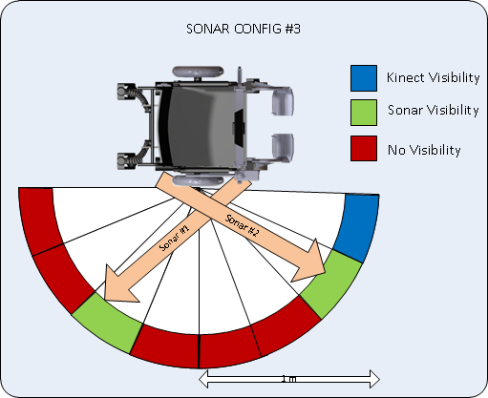
Testing/Integration

Slide 16
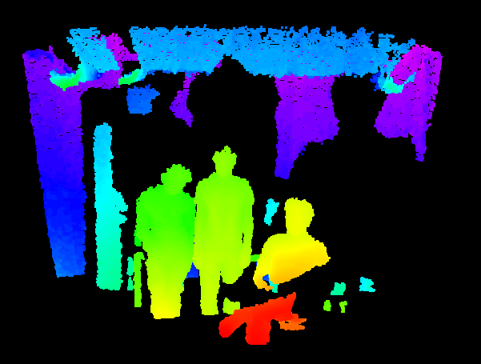
Kinect – Point Cloud

Slide 17
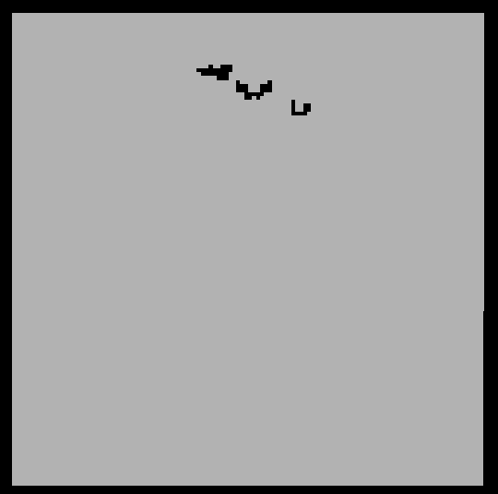
Kinect – Occupancy Map

Slide 18
Integration Progress
2 Options
Replace existing controller
Modify controller (analog interface)
Contingency
For prototype, replace motor controllers

Slide 19
Current BOM
Part | Count | Cost | Total
Xbox Kinect | 1 | 150 | 150$
Sonar Sensor | 4 | 30 | 120$
Sheet Metal (sq foot) | 4 | 3 | 12$
Spacers | 8 | 0.25 | 2$
PCB + Components | 1 | 150 | 120$
Basic Netbook | 1 | 350 | 350$
Total |  |  | 754$

Slide 20
Questions?

